Slide 1
BANK MANAGMENT SYSTEM USING SQL AND PL/SQL
M.PRANEETHA,
GMR INSTITUTE OF TECHNOLOGY
RAJAM,VIZAYNAGRAM

Slide 2
ABSTRACT
Bank management system in which to develop a software for solving financial applications of a customer in banking environment in order to nurture the needs of an end banking user by providing the various ways to perform banking tasks.it also to enable the users workspace to having additional functionalities which are not provide under a conventional software. The bank management system is an application for maintaining a persons account, deposit/withdraw the cash from his account, also to view reports of all account present

Slide 3
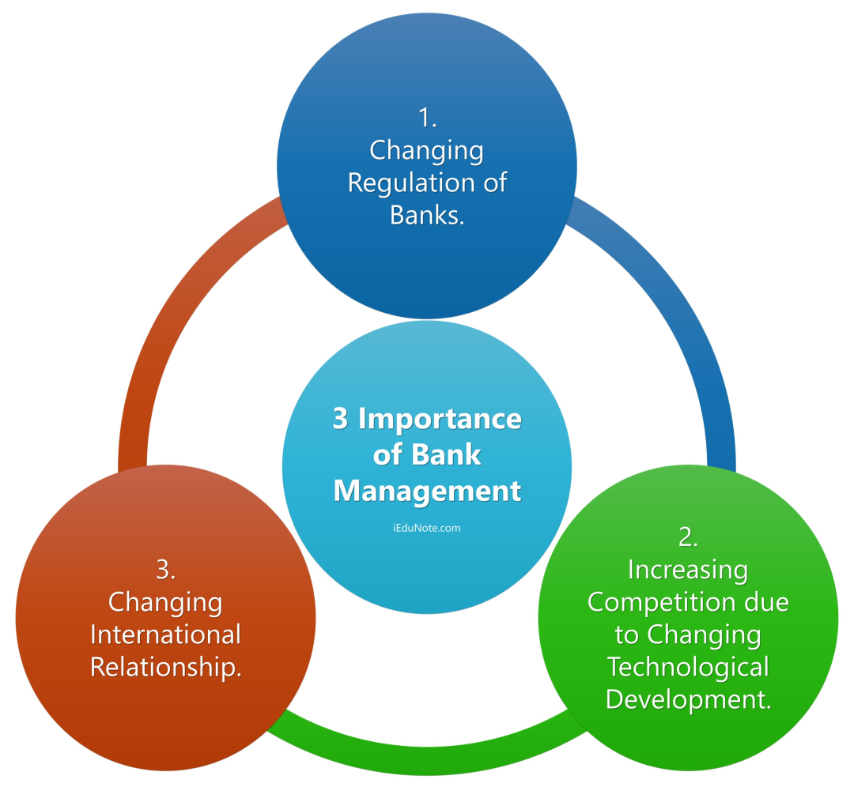
Introduction:
Bank management system it is the specific object of management financial relations connected with banking activates and other relations
Three main principles of banking system:
Changing Regulation of Banks.
Increasing competition due to
Changing Technological Development. Changing International Relationship.

Slide 4
What to expect:
Here some of the features available through online banking:
View balances: Firstly login your account with your account number and password.
Then checking your balance doesn't require much work. You simply select Account
balances and take a look at your balance and past transactions. If you have more than
one account, you can also do transfers between accounts.
2. Transfer funds: When you select Transfer Funds, you'll be asked where to transfer
the money to and from, when, and the amount.
3. Set up recurring bill payments or transfers: If you make a regular payment every
month, it might be convenient to set up an automatic withdrawal from your account.
4. Monitor CIBC investments: If you have any CIBC investments, you can keep an eye
on those stocks or mutual funds here.
5. Pay bills: To pay your bills online, you just need to add to your account the names of
the companies you wish to pay bills to.
6. View our VISA* accounts: Always a good place to monitor your spending. You can
make your credit card payments online, right from your account.
7. Order Cheques: We don't need them much anymore due to online banking and debit
purchases, but if you still use cheques, you can order them directly from the BAMS

Slide 5
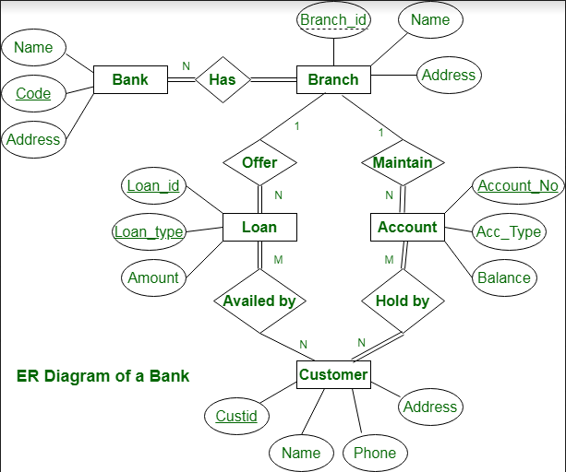
ER DIAGRAM:

Slide 6
Er Diagram
The Er diagram is nothing but design a diagram with components and attributes
In which the er diagram of bank system tells that it contain branch in rectangular block it has 4 attributes like branch_id, Name, Address
The relation ship between two attributes is represent by diamond box with has representation
The line shows that it can be generated next attribute with among the relation
The main attribute is customer entity in which the customer is the main role to perform bank operations

Slide 7
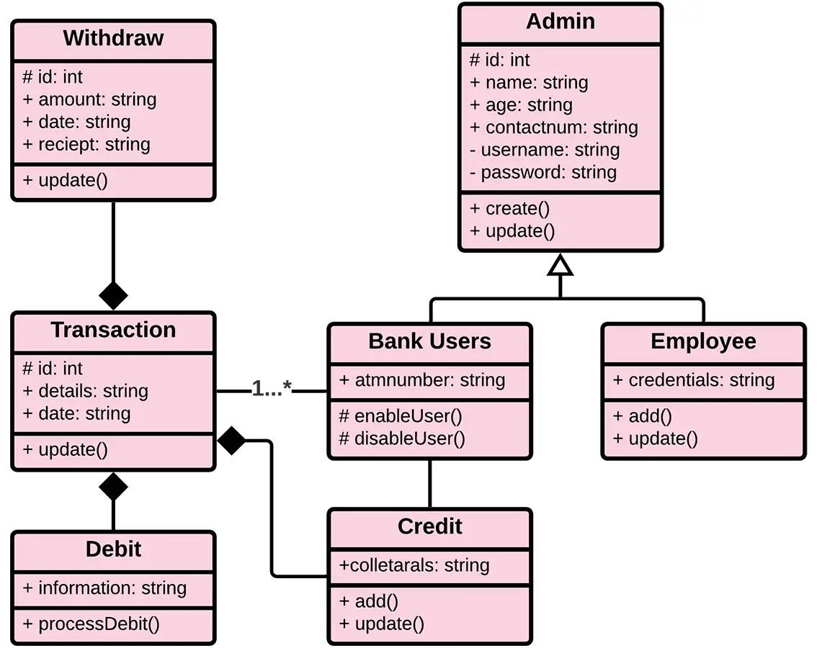
Class diagram:

Slide 8
Class diagram:
Class diagrams are a type of UML (Unified Modeling Language) diagram used in software engineering to visually represent the structure and relationships of classes in a system. UML is a standardized modeling language that helps in designing and documenting software systems.
Use Case Diagram:
Use Case Diagram is a vital tool in system design, it provides a visual representation of how users interact with a system. It serves as a blueprint for understanding the functional requirements of a system from a user’s perspective, aiding in the communication between stakeholders and guiding the development process

Slide 9
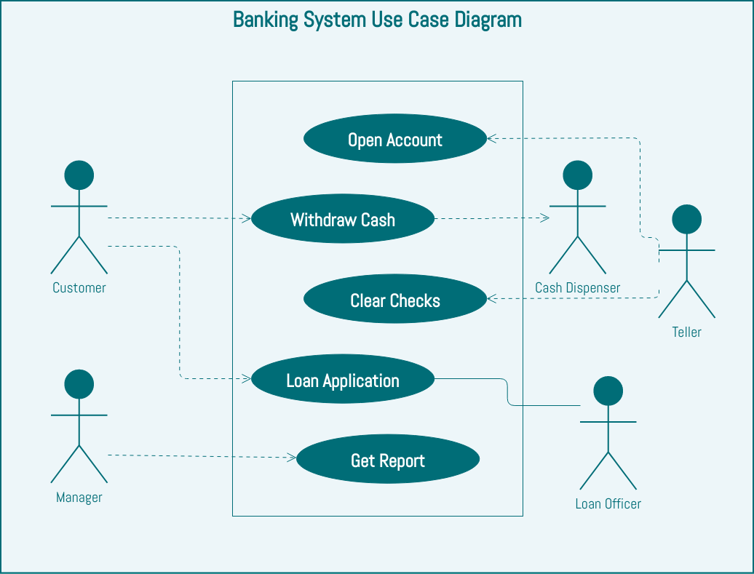
Use-case diagram

Slide 10
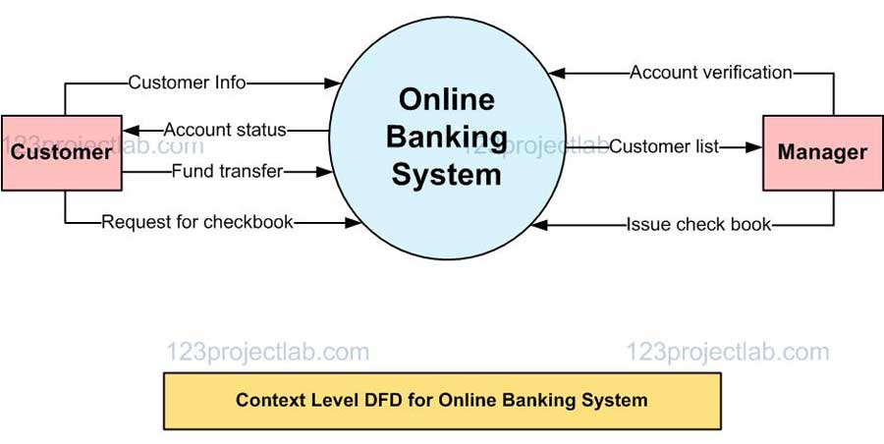
Techniques for bank:
Creating Account:
The bank database have two tables one called account and other called customer. Each hold information about either the account or the customer
It contain mainly 4 entities
1.CustId:create a unique customer id to the new customer
2.Name : stores the customer name
3.address:stores the customer address
4.acc_id:Links the customer to a account in the account table

Slide 11
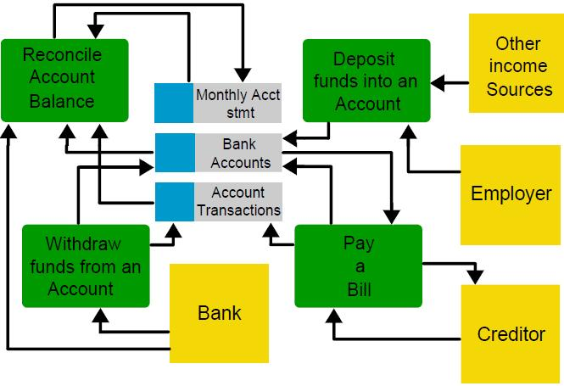
With draw:
With draw is the operation in which it retrive the money from bank.in which it deducted from your account and the cashier will give you the cash.it is third party signed such as attorney, manager and agent. the concerted action of depositors who try to withdraw their money... Bank withdrawal
Deposit:
A deposit generally refers to money held in a bank account. A deposit can also be the funds used as security or collateral for the delivery of goods or services. A demand deposit account is essentially a checking account in which you can withdraw funds at any time.

Slide 12
Bank Terms:
All requests received from customers are logged for backend fulfillment and are
effective from the time they are recorded at the branch.
2. Rules and regulations applicable to normal banking transactions in India will be
applicable mutatis mutandis for the transactions executed through this site.
3. The BAMS Bank service cannot be claimed as a right. The bank may also convert this
into a discretionary service anytime.
4. Dispute between the customer and the Bank in this service is subject to the
jurisdiction of the courts in the Republic of India and governed by the laws prevailing
in India.
5. The Bank reserves the right to modify the services offered or the Terms of service of
BAMS Bank. The changes will be notified to the customers through a notification on
the Site.

Slide 13
Introduction to sql:
Structured Query Language is a standard Database language that is used to create, maintain, and retrieve the relational database. In this article, we will discuss this in detail about SQL. Following are some interesting facts about SQL. Let’s focus on that.
SQL is case insensitive. But it is a recommended practice to use keywords (like SELECT, UPDATE, CREATE, etc.) in capital letters and use user-defined things (like table name, column name, etc.) in small letters.
We can write comments in SQL using “–” (double hyphen) at the beginning of any line. SQL is the programming language for relational databases (explained below) like MySQL, Oracle, Sybase, SQL Server, Postgre, etc. Other non-relational databases (also called NoSQL) databases like MongoDB, DynamoDB, etc. do not use SQL.
Although there is an ISO standard for SQL, most of the implementations slightly vary in syntax. So we may encounter queries that work in SQL Server but do not work in MySQL.

Slide 14
PL/SQL:
PL/SQL is a block structured language. The programs of PL/SQL are logical blocks that can contain any number of nested sub-blocks. Pl/SQL stands for "Procedural Language extension of SQL" that is used in Oracle. PL/SQL is integrated with Oracle database (since version 7). The functionalities of PL/SQL usually extended after each release of Oracle database. Although PL/SQL is closely integrated with SQL language, yet it adds some programming constraints that are not available in SQL.
The PL/SQL is known for its combination of data manipulating power of SQL with data processing power of procedural languages. It inherits the robustness, security, and portability of the Oracle Database.

Slide 15
Example:
DECLARE
pi number=3.1415
radius number(5,2);
dia number(5,2);
circumference number(7,2)
area number(10,2)
BEGIN
Radius:=9.5;
dia :=radius*2;
Circumference=2.0*pi*radius;
Area: pi*radius*radius
Dbms_output.put_line(‘Radius’||radius);
Dbms_output.put_line(‘Diameter’||diameter);
Dbms_output.put_line(‘circumference’||circumfernce);
Dbms_output.put_line(‘Area’||area);

Slide 16
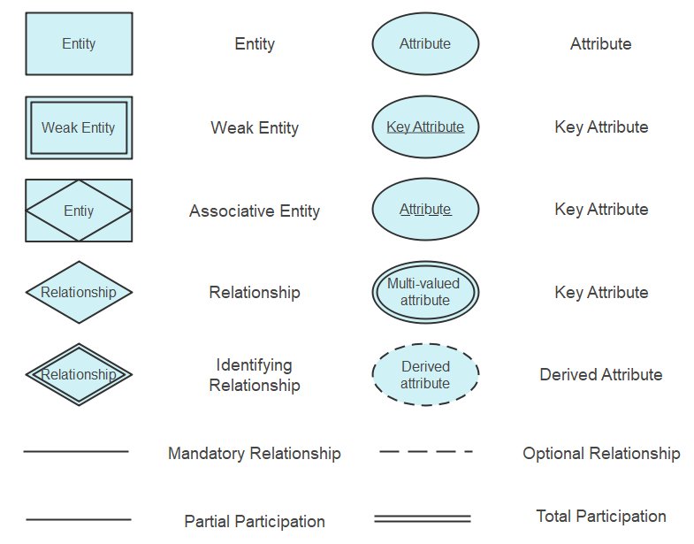
Creation of sql code

Slide 17
Creating tables
Create table bank(b_id integer primary key, b_name varchar(60),b_address vachar(80),b_phno integer);
Create table account(acc_no integer,cust_id integer,b_id integer,opening_bal integer,aod DATE,atype varchar(80));
Create table transdetails(t_id integer,acc_no integer,dot DATE,transaction_type varchar(80),trans_amount varchar(80));
Create table loan(cust_id integer,b_id integer,loan_amount integer));

Slide 18
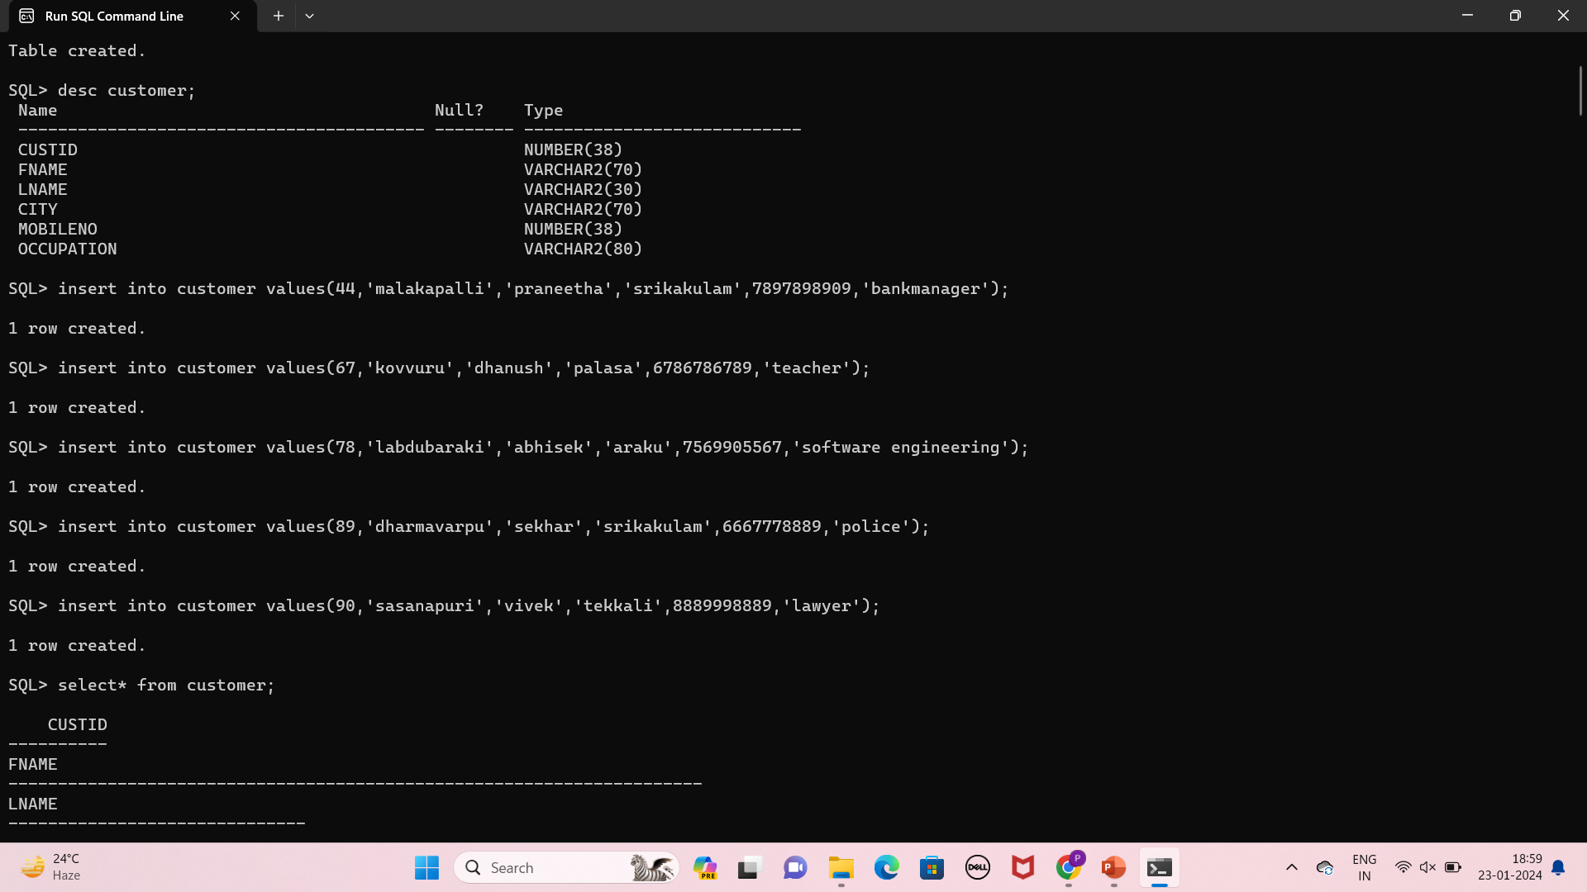
create table customer(custid integer,fname varchar(70),lname varchar(30),city varchar(70),mobileno integer,occupation varchar(80));

Slide 19
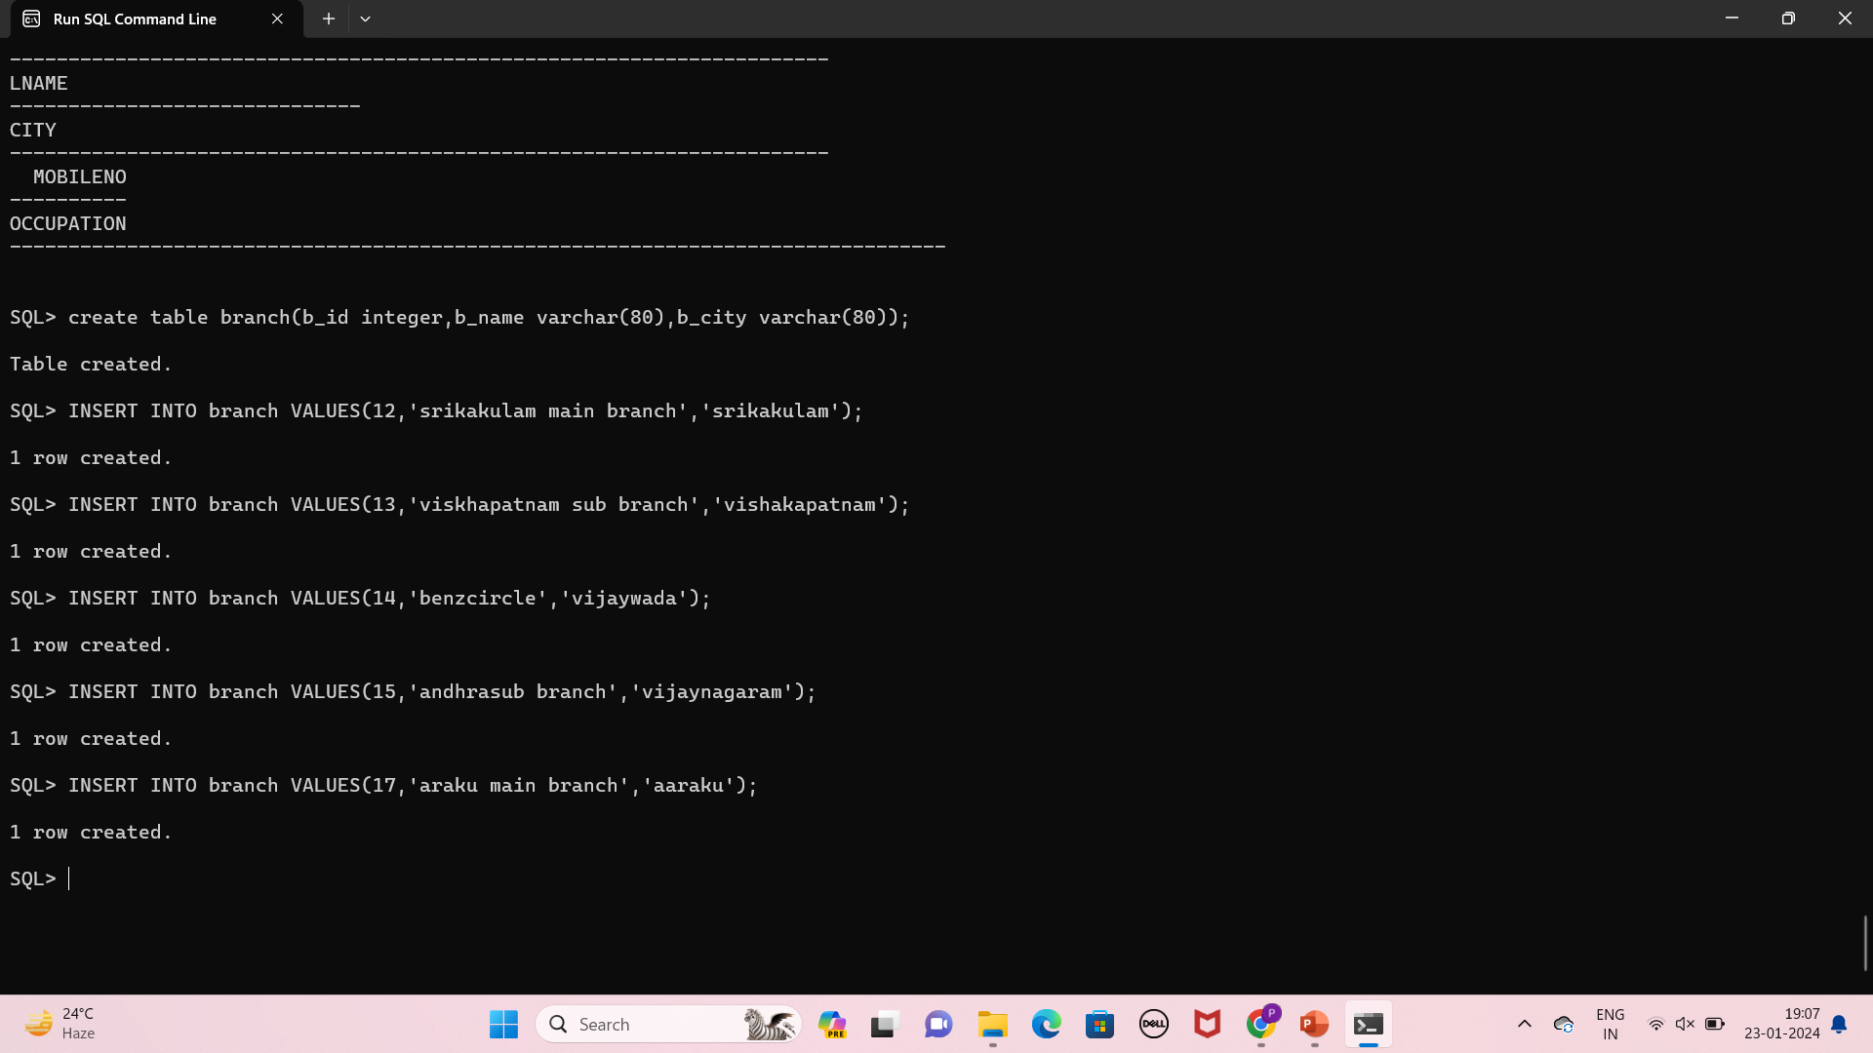
Create table branch(b_id integer,b_name varchar(80),b_city varchar(90));

Slide 20
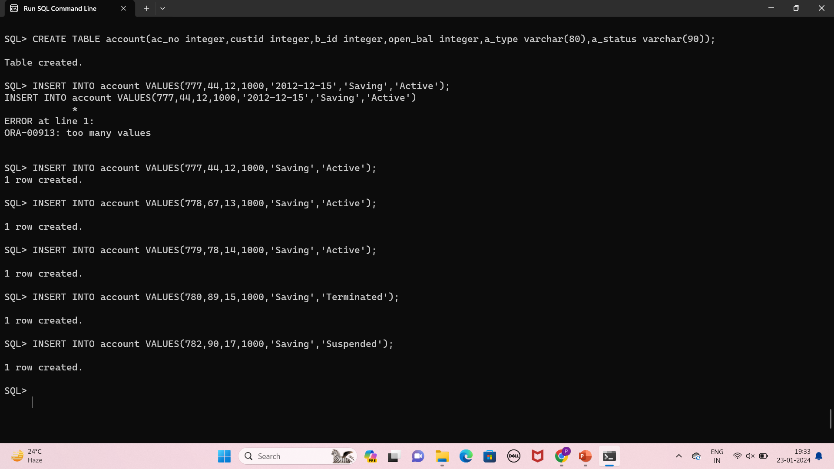
CREATE TABLE account(ac_no integer,custid integer,b_id integer,open_bal integer,a_type varchar(80),a_status varchar(90));

Slide 21
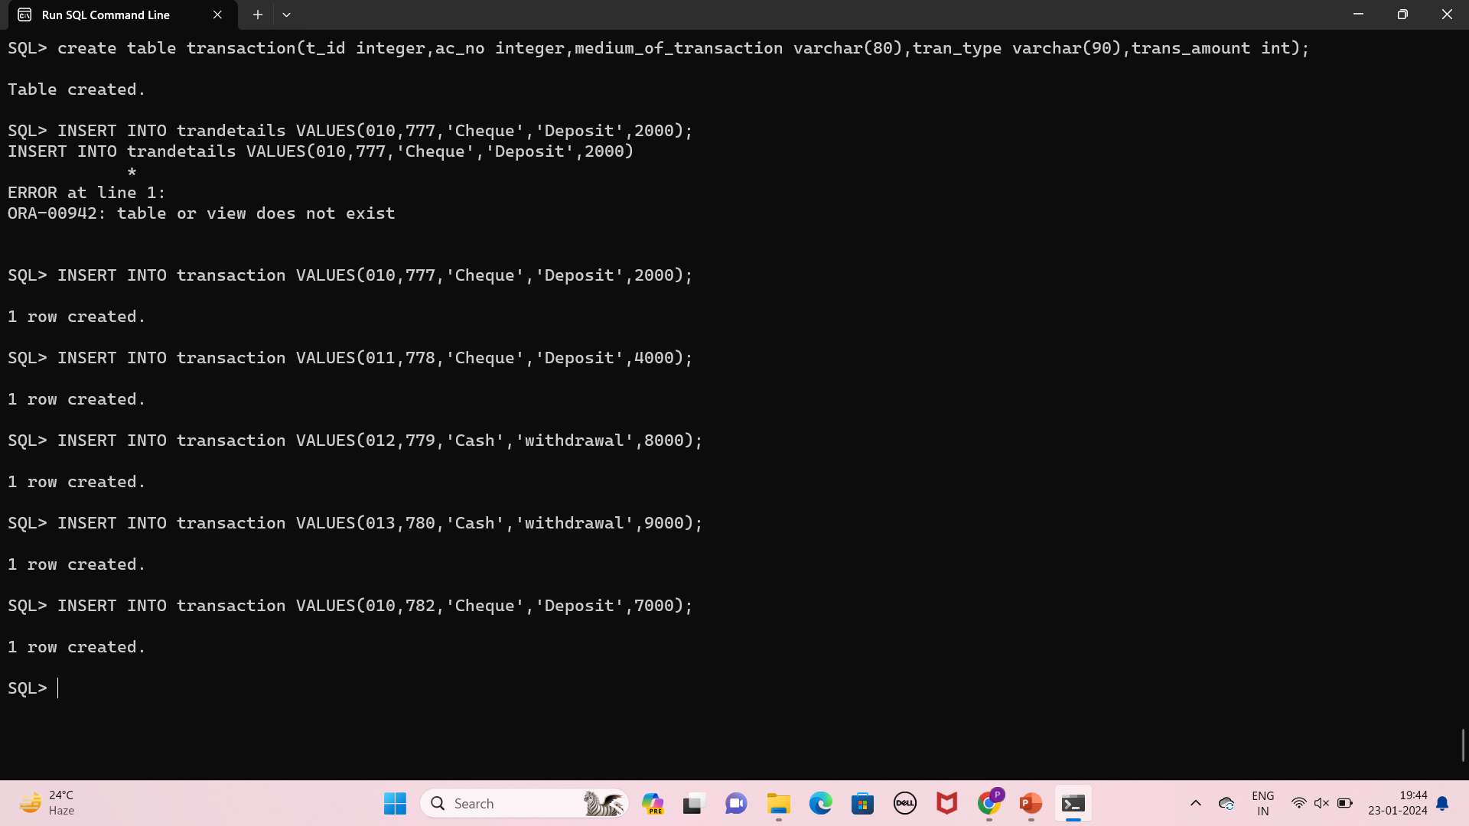
create table transaction(t_id integer,ac_no integer,medium_of_transaction varchar(80),tran_type varchar(90),trans_amount int);

Slide 22
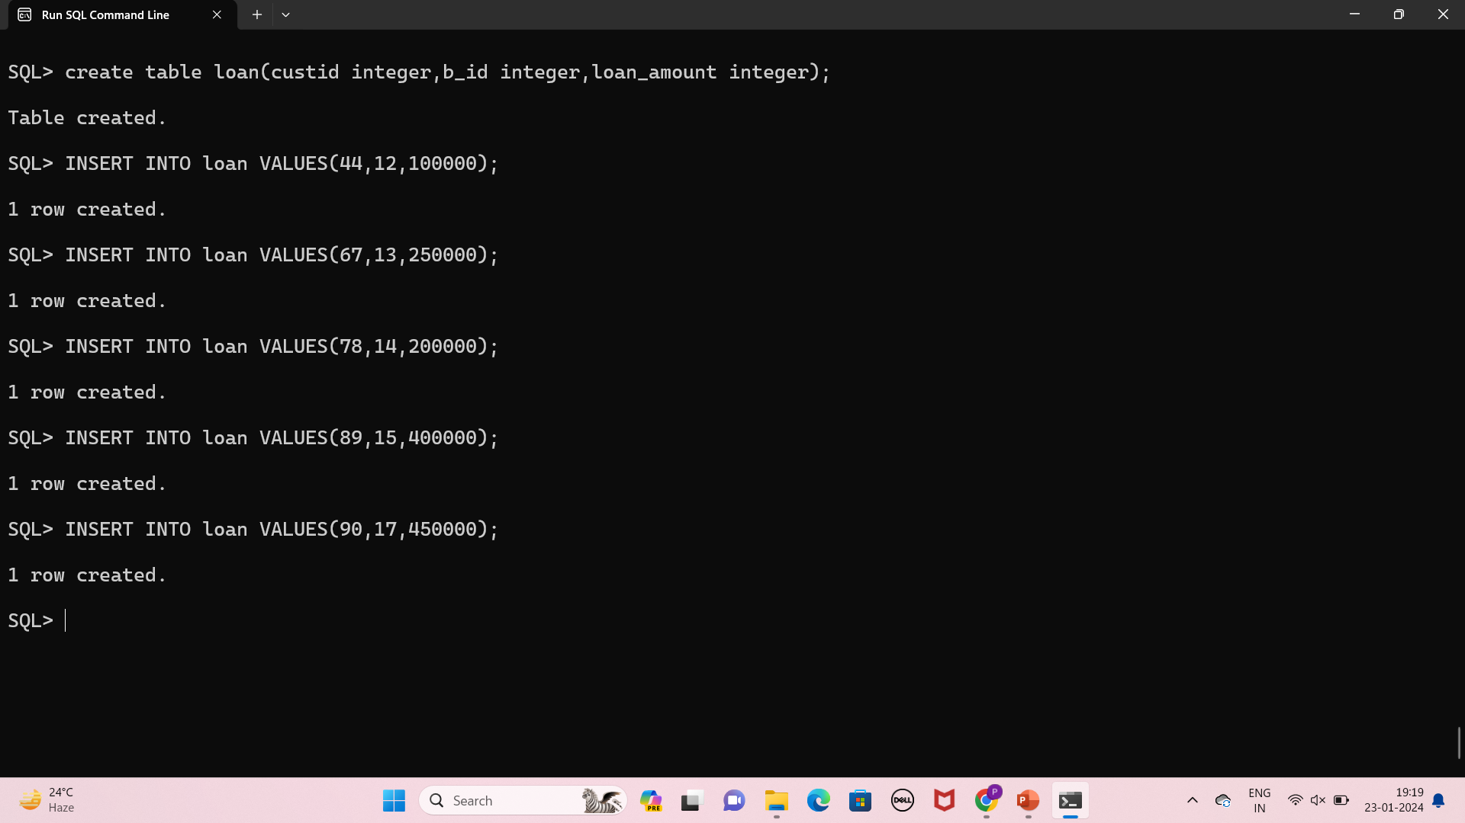
create table loan(custid integer,b_id integer,loan_amount integer);

Slide 23
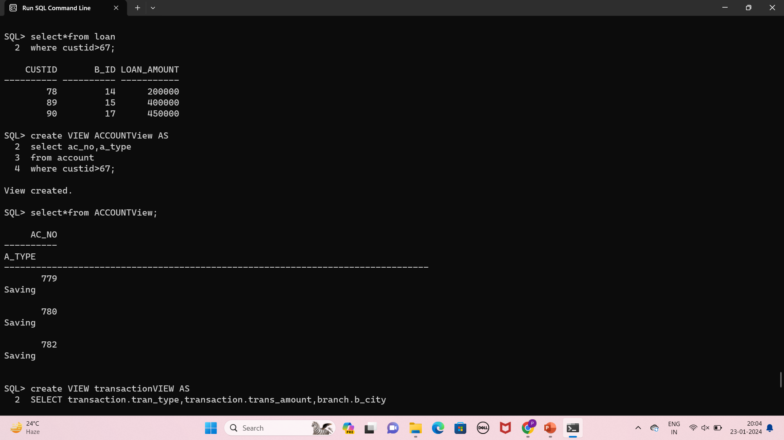
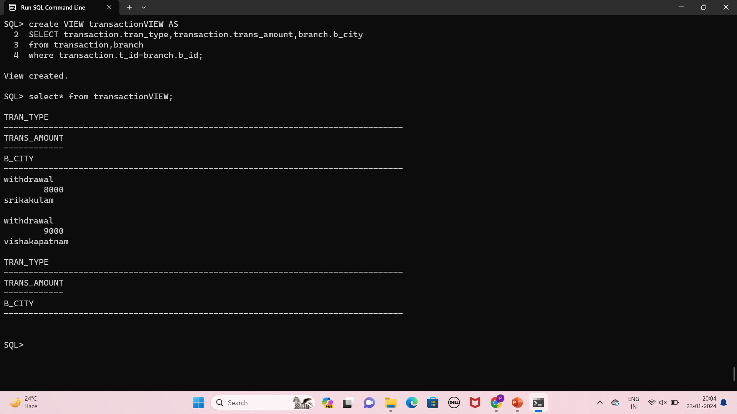
Some basic operations like views

Slide 24
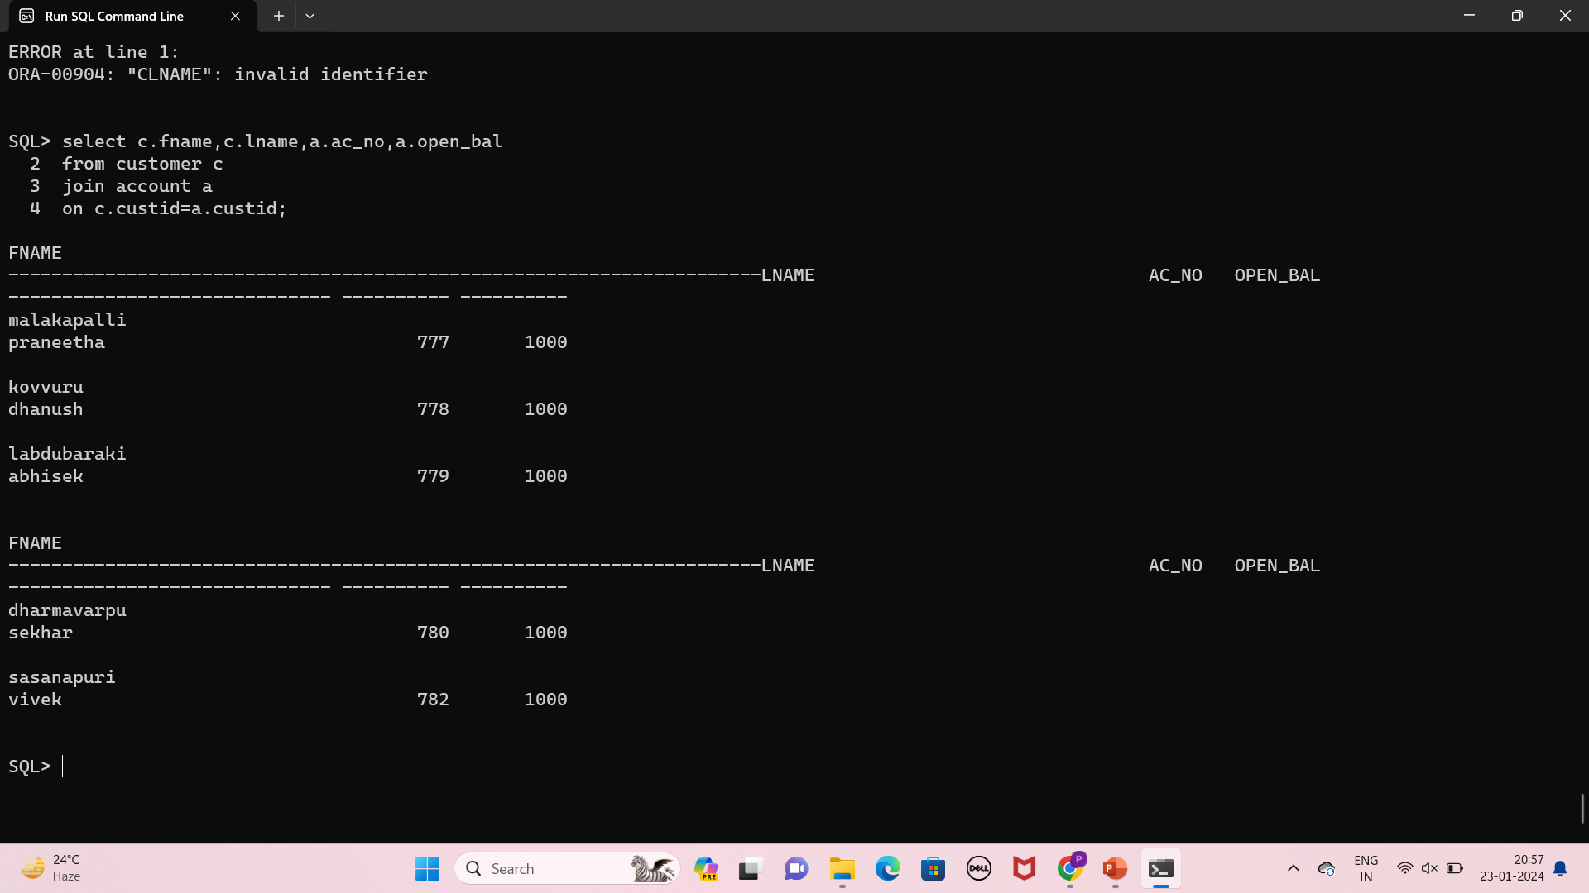
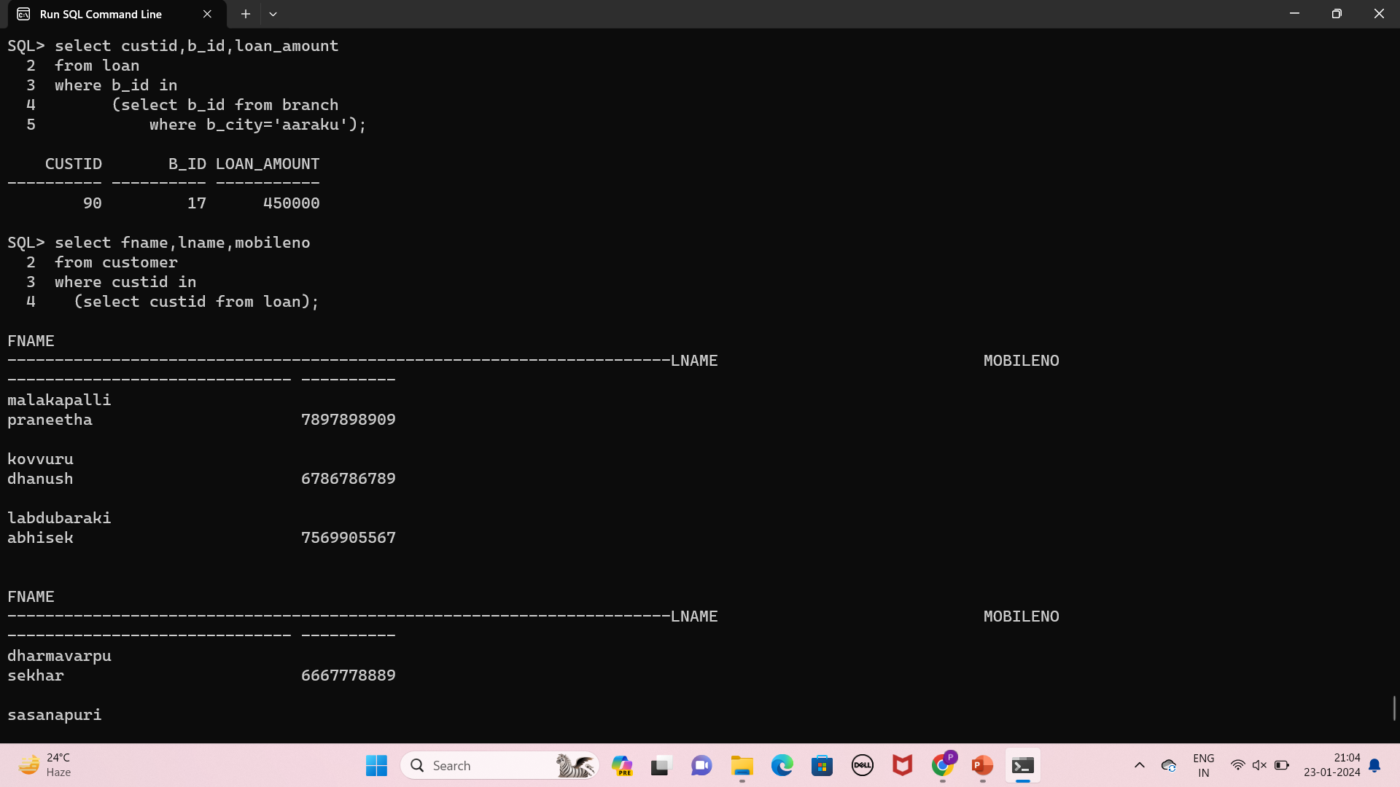
Joins,subqueries

Slide 25
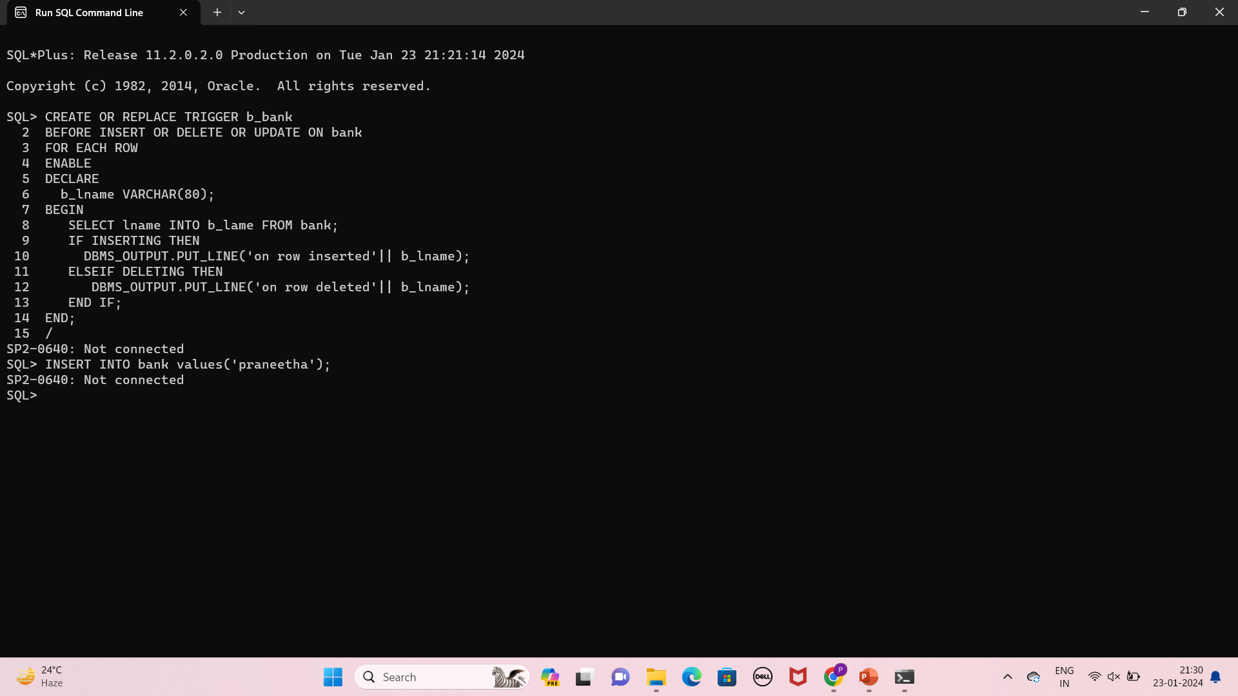
PL/SQL

